Slide 1
Adobe Illustrator - CC

Slide 2

TRAINING OUTLINE
About Illustrator
Getting Started
CC Features
Assignments

Slide 3
About
Illustrator

Slide 4
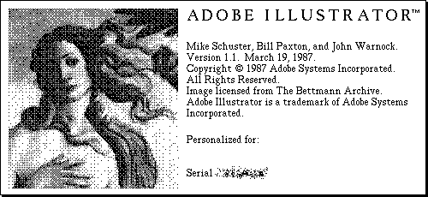
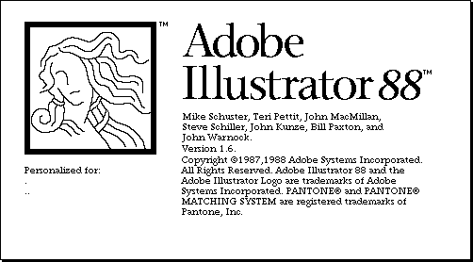
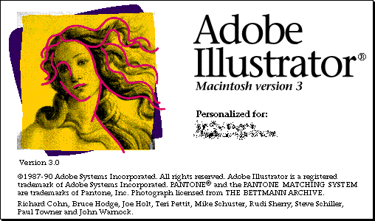
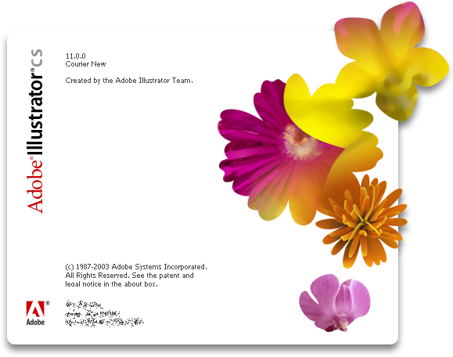
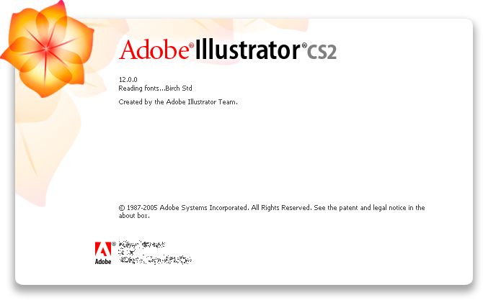
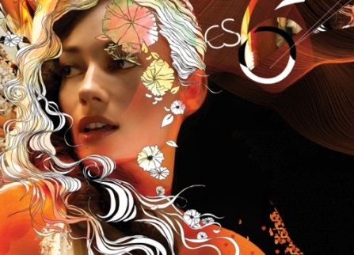
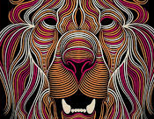
History
Adobe Illustrator is a vector graphics editor developed and marketed by Adobe Systems
Corel DRAW, Xara Designer Pro and Macromedia FreeHand are its core competitors
Its got its seventh generation released with CC from the way early Illustrator 1.0
The first version was for a Mac
Rated as the most popular digital drawing programs

Slide 5
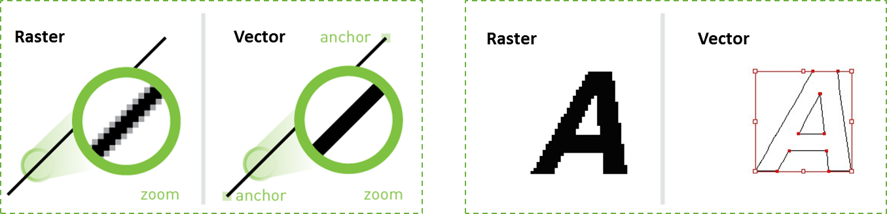
Key Concepts
VECTOR:
Made up of points and paths using a mathematical relationship
Best for printing graphics and logos
Can be resized to any size without distortion
File types: AI, EPS, SVG, CDR
RASTER:
Made up of dots/squares called pixels which are part of a grid
Best for photography and viewing images on the web or on monitors
Cannot be resized without losing image quality, well because of fixed pixel grid
File types: JPEG, PNG, GIF, PSD and TIF (…just to name a few)

Slide 6
Key Concepts
Vector graphics software
Lets you create logos, icons, sketches, typography, and complex illustrations for print, web, interactive, video, and mobile.
Advantages
Scalable without resolution loss (uses mathematical equations to draw out the shapes which makes vector graphics scalable without the loss of resolution)
Lines are crisp and sharp at any sizes
Print at high resolution
Smaller file size
Good for drawing illustrations
Deprivations with Illustrator
Drawings tend to look flat and cartoon
Hard to produce photo realistic drawings

Slide 7




Common Usage
Logo Design

Slide 8
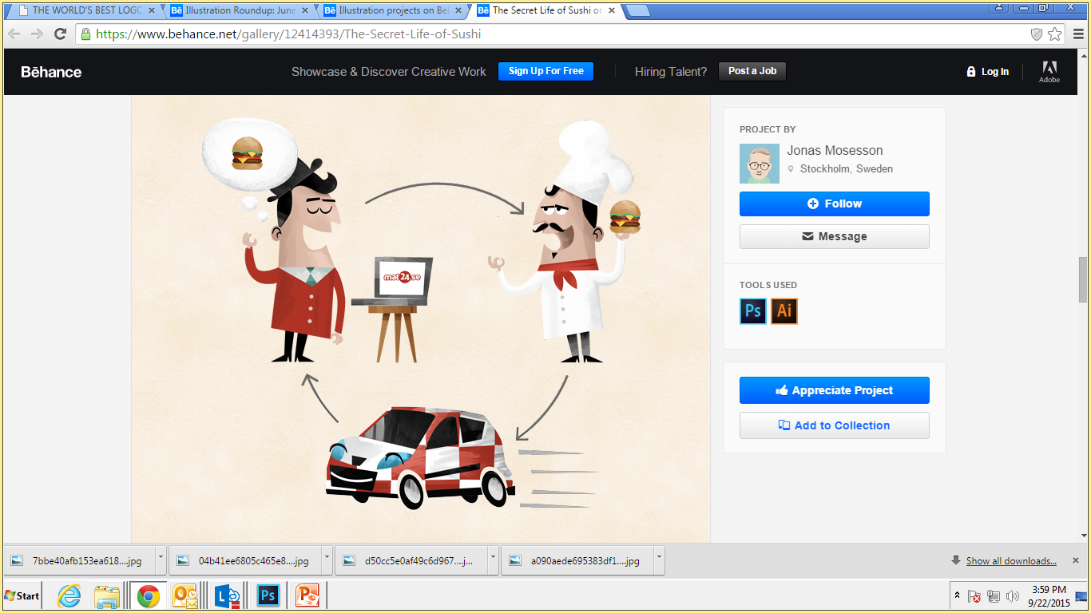
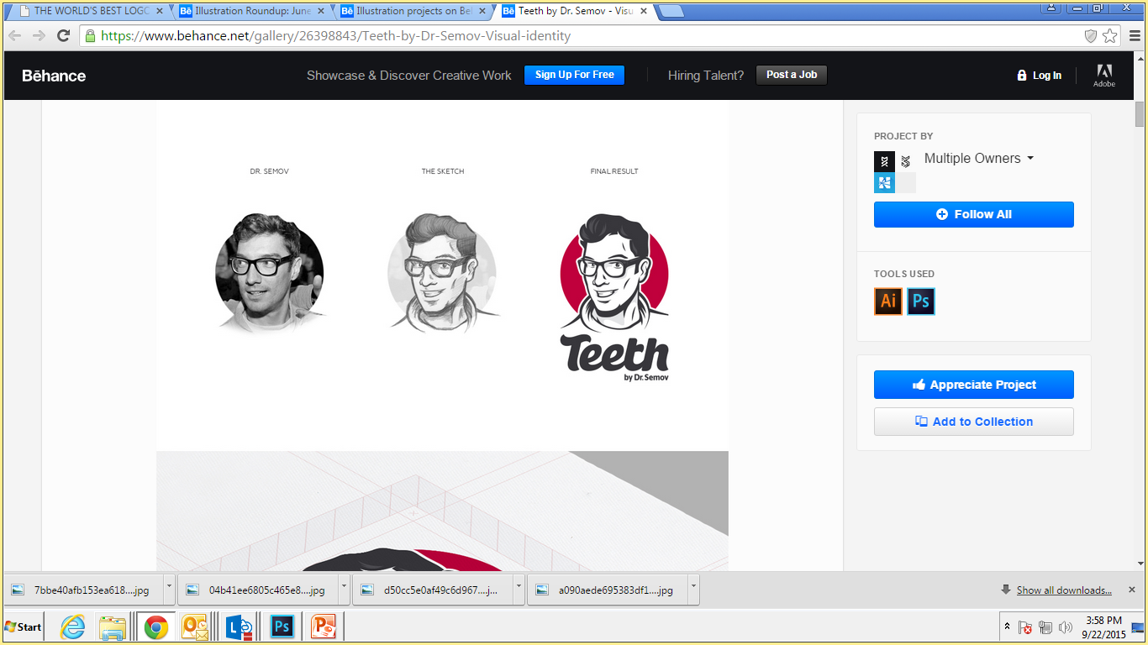
Common Usage
Character Design

Slide 9
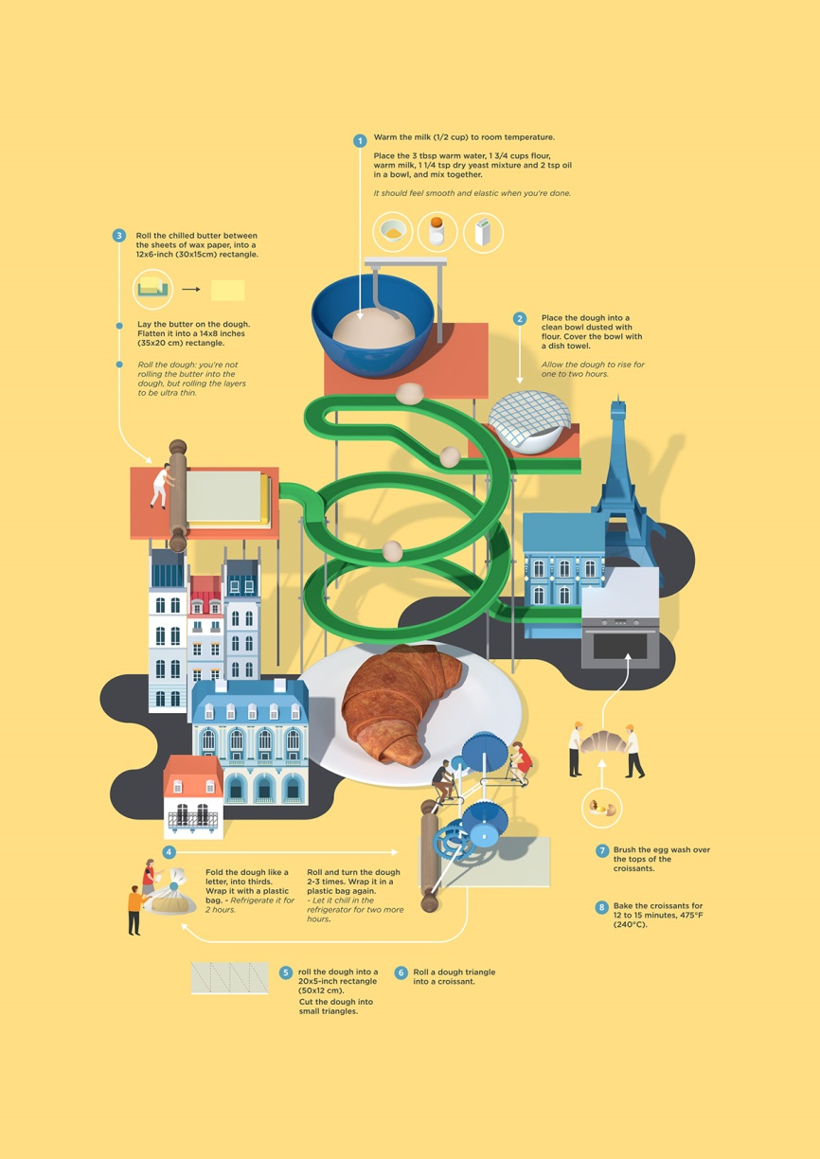
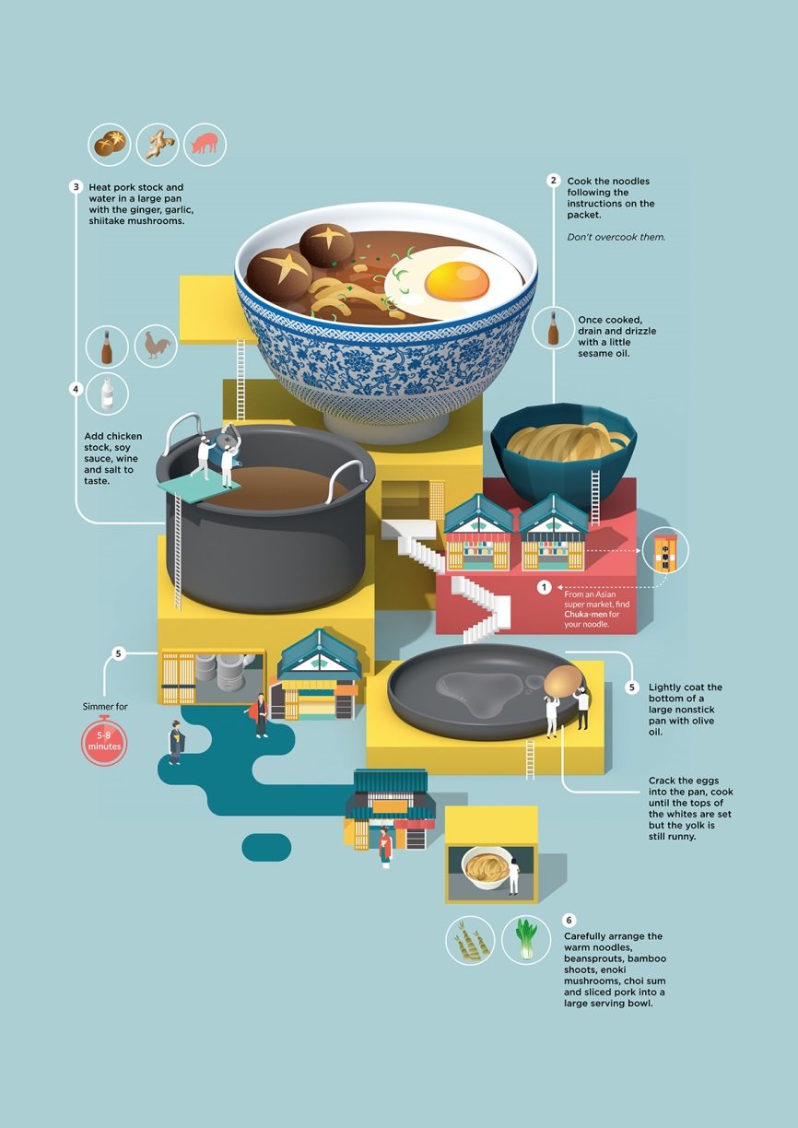
Common Usage
Info Graphics

Slide 10
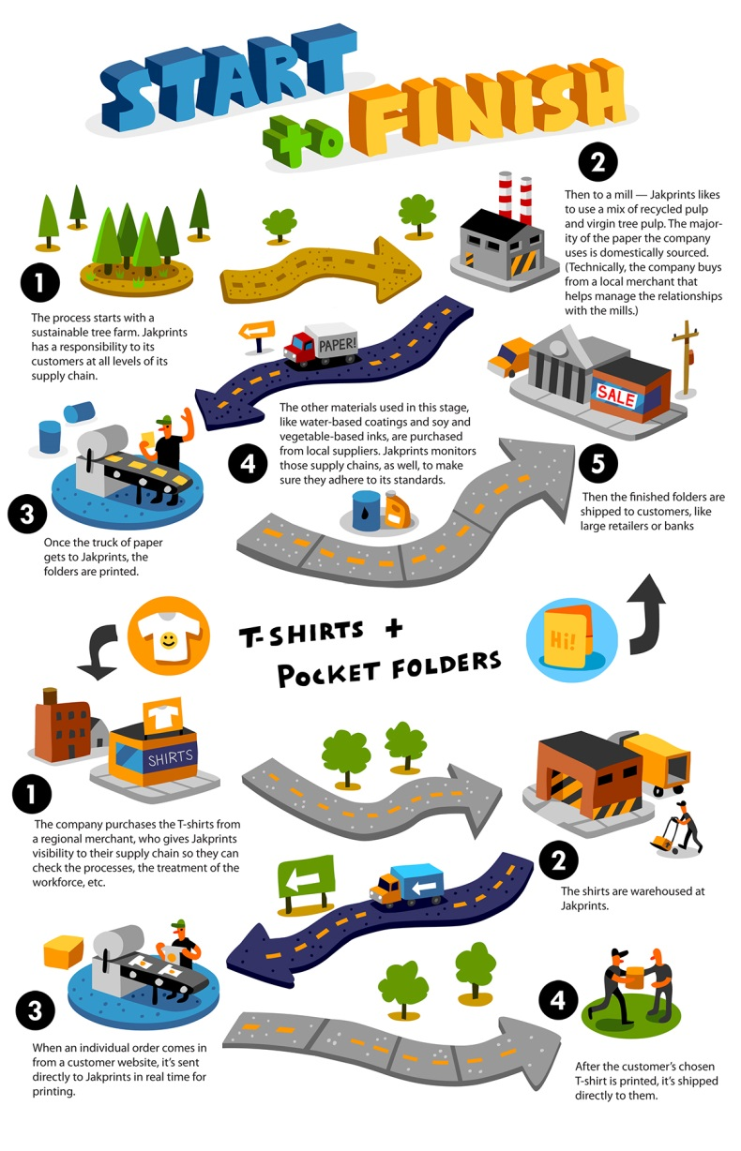

Common Usage
Poster Design

Slide 11
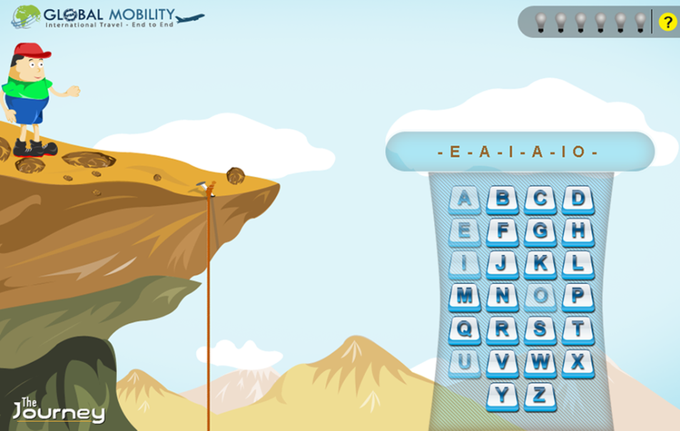
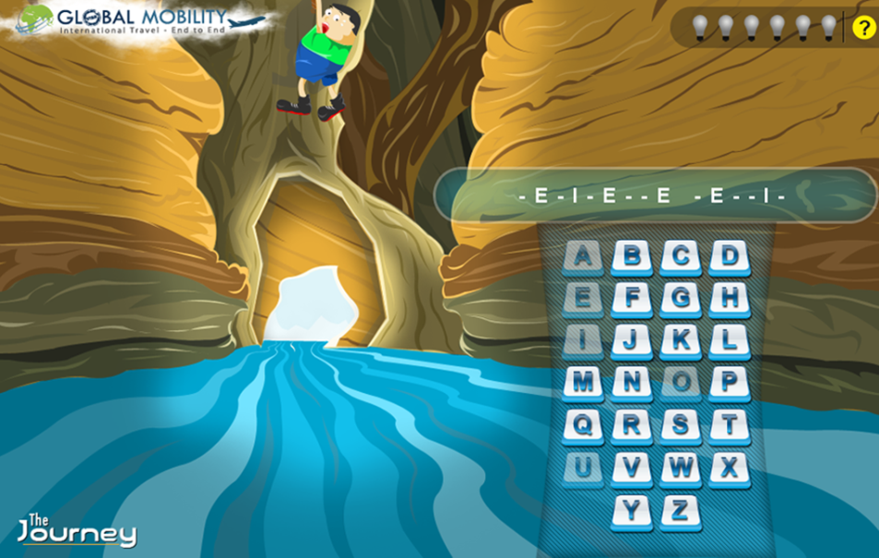

Common Usage
Gamification

Slide 12
Getting
Started

Slide 13
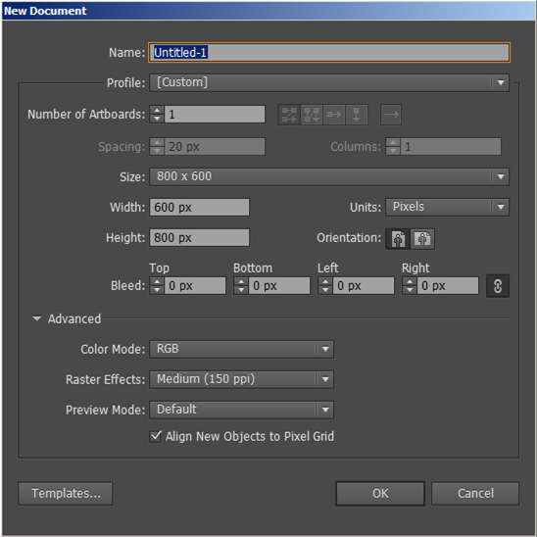
New Document Profiles

Slide 14
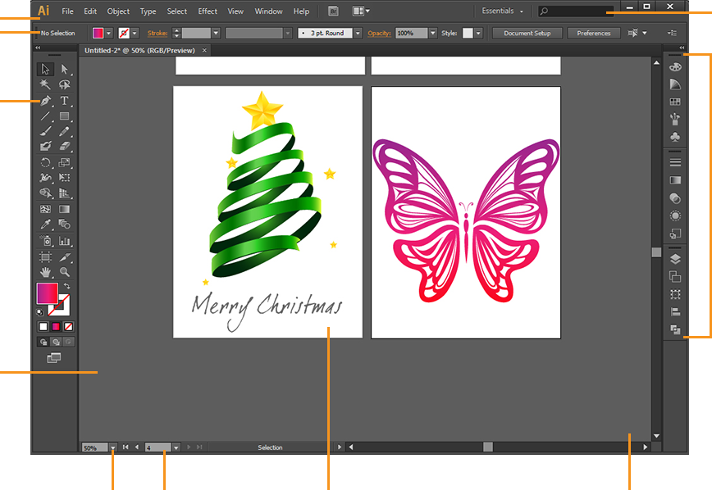
Illustrator Work Space
Workspace
Switcher
menu
Application Bar
Control Panel
Tools Panel
Panels
Document
View
Zoom
Level
Artboard
Navigation
Artboard
Scratch Area

Slide 15
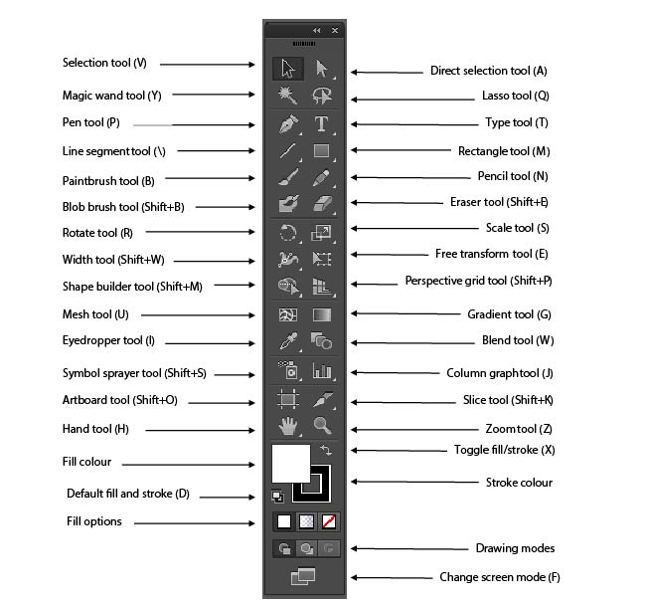
Tools

Slide 16
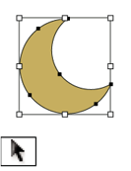
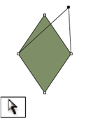
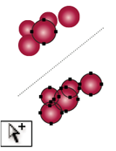
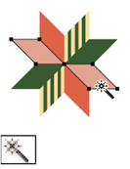
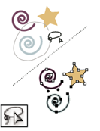
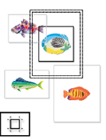
Tools
Selection Tools
The Selection tool (V)
selects entire objects.
The Direct Selection tool (A) selects points or path segments within objects
The Group Selection tool selects objects and groups within groups
The Magic Wand tool (Y) selects objects with similar attributes.
The Lasso tool (Q) selects points or path segments within objects
The Artboard tool creates separate artboards for printing or export

Slide 17
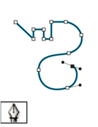
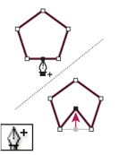
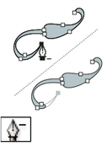
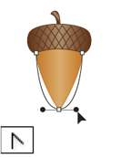
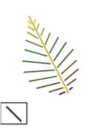
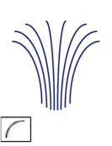

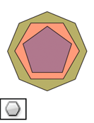
Tools
Drawing tools
The Pen tool (P) draws straight and curved lines to create objects.
The Add Anchor Point tool (+) adds anchor points to paths
The Delete Anchor Point tool (-) deletes anchor points from paths.
The Convert Anchor Point tool (Shift+C) changes smooth points to corner points and vice versa.
The Line Segment tool (\) draws individual straight line segments
The Arc tool draws individual concave or convex curve segments.
The Spiral tool draws
clockwise and counterclockwise
spirals.
The Polygon tool draws
regular, multi-sided shapes.

Slide 18

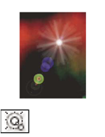
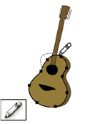
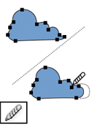
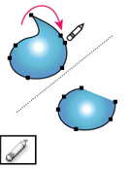
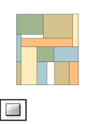
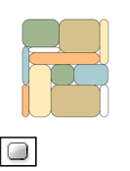
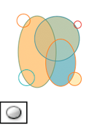
Tools
Drawing tools
The Star tool draws stars.
The Flare tool creates lens-flare
or solar-flare-like effects.
The Pencil tool (N) draws
and edits freehand lines
The Smooth tool smooths
Bezier paths
The Path Eraser tool erases
paths and anchor points
from the object.
The Rectangle tool (M)
draws squares and rectangles.
The Rounded Rectangle
tool draws squares and
rectangles with rounded
corners.
The Ellipse tool (L)
draws circles and ovals.

Slide 19
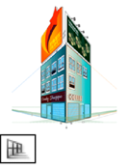
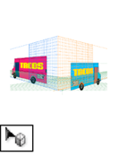
Tools
Drawing tools
The Perspective Grid allows creating and rendering artwork in perspective.
The Perspective Selection tool allows you to bring objects, text, and symbols in perspective, move objects in perspective, move objects in perpendicular to its current direction

Slide 20
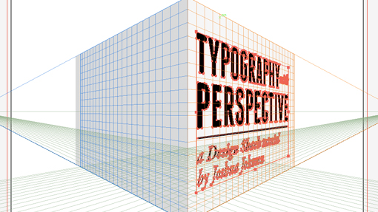
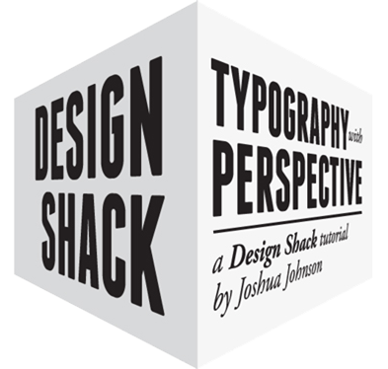
Tools
Drawing tools - Examples

Slide 21
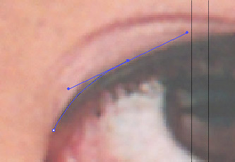
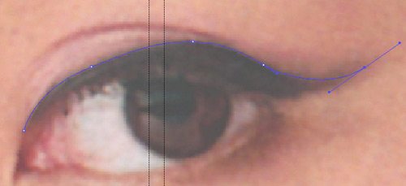
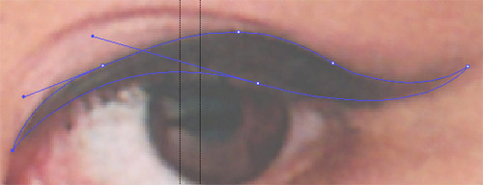
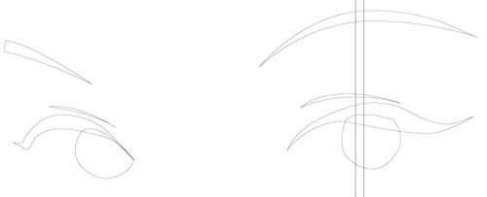

Tools
Pen Tool – Example (Tracing)
1
2
3
4
5

Slide 22
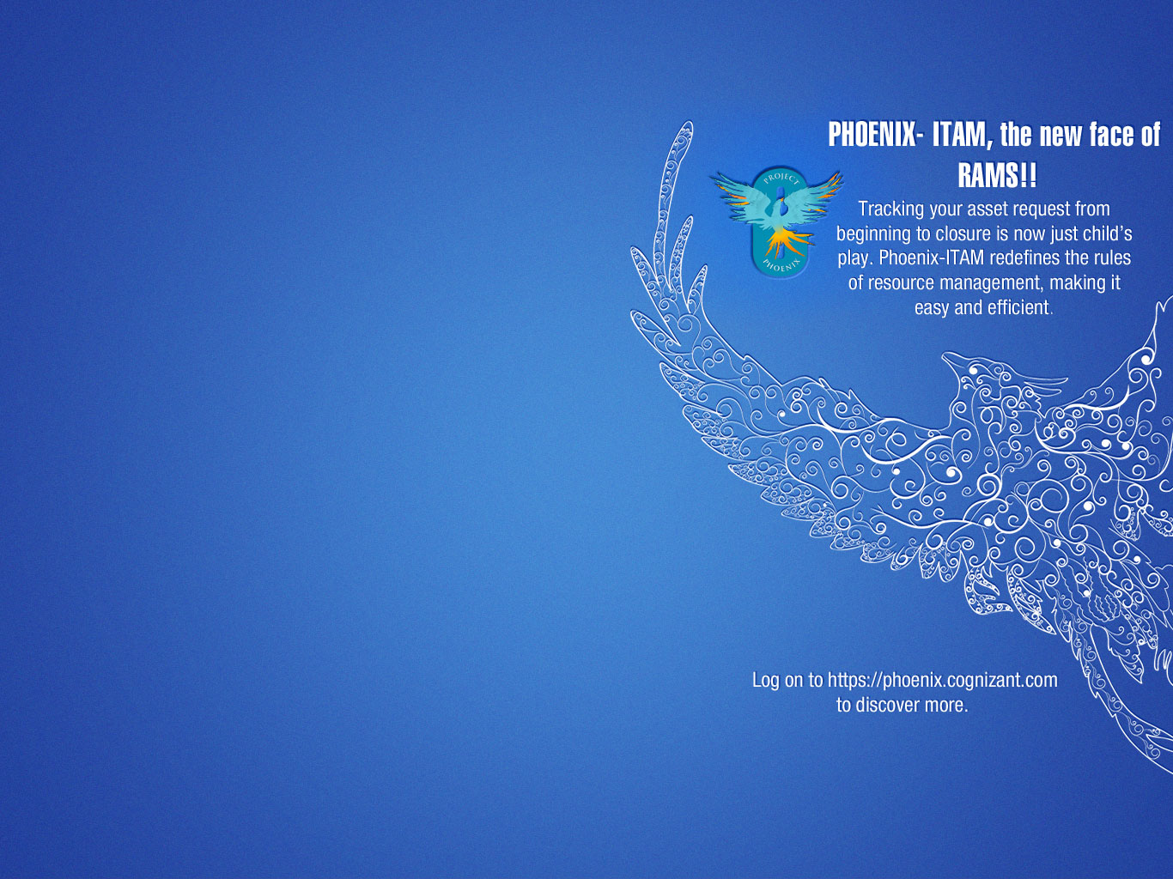
Tools
Pen Tool – Derivatives

Slide 23
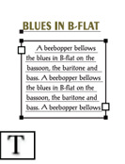
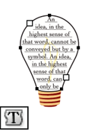
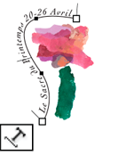



Tools
Type tools
The Type tool (T) creates
individual type and type containers
and lets you enter and edit type.
The Area Type tool changes
closed paths to type containers
and lets you enter and edit
type within them.
The Type On A Path tool changes
paths to type paths, and lets you
enter and edit type on them.
The Vertical Type tool creates
vertical type and vertical type
containers and lets you enter
and edit vertical type
The Vertical Area Type tool
changes closed paths to vertical
type containers and lets you
enter and edit type within them.
The Vertical Type On A Path tool
changes paths to vertical type
paths and lets you enter and
edit type on them

Slide 24







Tools
Painting tools
The Paintbrush tool (B) draws
freehand and calligraphic lines,
as well as art, patterns, and
bristle brush strokes on paths.
The Mesh tool (U) creates and
edits meshes and mesh envelopes.
The Gradient tool (G) adjusts the
beginning and ending points and
angle of gradients within objects,
or applies a gradient to objects.
The Live Paint Bucket tool (K)
paints faces and edges of Live
Paint groups with the current
paint attributes.
The Live Paint Selection (Shift-L)
tool selects faces and edges
within Live Paint groups.
The Blob Brush tool (Shift-B)draws paths that automatically
expand and merge calligraphic brush paths that share the
same color and are adjacent in stacking order.
The Eyedropper tool (I) samples and
applies color, type, and appearance
attributes, including effects,
from objects.

Slide 25









Tools
Gradient + Mesh tool - Examples
1
2
3
4
5
FINAL

Slide 26






Tools
Gradient + Mesh tool - Examples
2
1
FINAL
3
4

Slide 27







Tools
Reshaping tools
The Rotate tool (R) rotates
objects around a fixed point.
The Reflect tool (O) flips objects
over a fixed axis.
The Scale tool (S) resizes objects
around a fixed point.
The Shear tool skews
objects around a fixed
point.
The Reshape tool adjusts selected
anchor points while keeping the
overall detail of the path intact.
The Free Transform tool (E) scales, rotates,
or skews a selection.
The Blend tool (W) creates a series of objects blended
between the color and shape of multiple objects.

Slide 28







Tools
Reshaping tools
The Twirl tool creates swirling
distortions within an object.
The Warp tool (Shift+R) molds
objects with the movement of
the cursor (like molding clay,
for example).
The Bloat tool inflates an object
by moving control points away
from the cursor.
The Pucker tool deflates
an object by moving control
points towards the cursor.
The Crystallize tool adds
random spiked details to
the outline of an object.
The Wrinkle tool adds wrinkle-like
details to the outline of an object.
The Scallop tool adds random curved
details to the outline of an object.

Slide 29




Tools
Blend tool - Examples
1
1
1
2
2
2

Slide 30







Tools
Gradient, Blend, Mesh Tools - Examples
1
2
3
Final Output
1
2
3
Final Output

Slide 31








Tools
Symbolism tools
The Symbol Sprayer tool (Shift+S)
places multiple symbol instances
as a set on the artboard.
The Symbol Shifter tool moves
symbol instances and change
stacking order
The Symbol Scruncher tool moves
symbol instances closer together
or farther apart.
The Symbol Sizer tool resizes
symbol instances.
The Symbol Spinner tool
rotates symbol instances.
The Symbol Stainer tool
colorizes symbol instances
The Symbol Screener tool
applies opacity to symbol instances.
The Symbol Styler tool applies
the selected style to symbol
instances

Slide 32









Tools
Graph tools
The Column Graph tool (J)
creates graphs that compare
values using vertical columns.
The Stacked Column Graph tool
creates graphs that are similar to
column graphs, but stacks the columns
on top of one another, instead of side
by side.
The Bar Graph tool creates graphs
that are similar to column graphs,
but positions the bars horizontally
instead of vertically.
The Stacked Bar Graph tool
creates graphs that are similar
to stacked column graphs,
but stacks the bars horizontally
instead of vertically.
The Line Graph tool
creates graphs that use
points to represent one or
more sets of values, with
a different line joining
the points in each set.
The Area Graph tool
creates graphs that are
similar to line graphs,
but emphasizes totals
as well as changes in
values.
The Scatter Graph tool creates
graphs that plot data points as
paired sets of coordinates along
the x and y axes.
The Pie Graph tool creates
circular graphs whose wedges
represent the relative
percentages of the
values compared.
The Radar Graph tool
creates graphs that
compare sets of values
at given points in time
or in particular categories,
and is displayed in a
circular format.

Slide 33


Tools
Graph tools - Examples

Slide 34




Palette Options
Color panel
A. Fill color B. Stroke color C. Panel menu
D. None box E. Color spectrum bar
F. Color slider G. Text box for a color component
Swatches panel
A. Spot color
B. Global color
C. Fill or stroke of None
D. Registration swatch (prints on all plates)
E. CMYK symbol (when document is open in CMYK mode)
F. RGB symbol (when document is open in RGB mode)
G. Swatch Library Menu button
H. Show Swatch Kinds Menu button
I. Swatch Options button
J. New ColorGroup button
K. New Swatch button
Appearance panel
A. Path with stroke, fill, and drop shadow effect
B. Path with effect
C. Add New Stroke button
D. Add New Fill button
E. Add Effect button
F. Clear Appearance button
G. Duplicate Selected Item button

Slide 35




Palette Options
Layers panel
A. Visibility column B. Edit column
C. Target column D. Selection column

Slide 36

Saving & Printing
Adobe Illustrator Document (.ai) This is Adobe’s native Illustrator format, and only Illustrator is able to read this file format.
Illustrator EPS (.eps) This long-standing file format, which is short for Encapsulated PostScript, is supported by most all standard graphics applications.
illustrator Template (.ait)
This format is exactly what it says. It’s a template format for Illustrator that allows you to save your file as a template for using as a “building block” for later files.
SVG Compressed (.svgz) and SVG (.svg)
SVG stands for Scalable Vector Graphics and is an XML markup language for describing two-dimensional vector graphics, both static and animated and is an open standard created by the World Wide Web Consortium.
Saving for Web
HTML (html)
Image (gif)
JPEG (jpg)
PNG (png)
Export file formats in illustrator
Amiga IFF (.iff )
AutoCAD Drawing (.dwg)
AutoCAD Interchange File (.dxf )
Computer Graphics Metafile (.cgm)
Enhanced Metafile (.emf )
Flash (.swf )
JPEG (.jpg)
Export file formats in illustrator
Macintosh PICT (.pct)
Paintbrush (.pcx)
Photoshop (.psd)
Pixar (.pxr)
Scalable Vector Graphics (.svg)
SVG Compressed (.svgz)
Targa (.tga)
Export file formats in illustrator
Text (.txt)
Tagged Image File Format (.tif )
Windows Metafile (.wmf )

Slide 37
Creative Cloud
Features

Slide 38



User Interface
Gradients on Stroke

Slide 39


Image Trace
Original Image
High Color Trace
Silhouette Trace
Creating Patterns

Slide 40





Touch type tool

Slide 41







Bitmap Brushes
1
2
3
5
4
Final Output

Slide 42







Auto Corners for Pattern Brushes
1
2
3
4
Final Output
5
Sample Label

Slide 43


Package Files
Menu > File > Package
1
2
3

Slide 44


Font Search

Slide 45
Assignments

Slide 46


NOW!
IS THE TIME FOR
ILLUSTRATOR TO WORK ON YOU. LET’S GET INSPIRED

Slide 47

NOW!
IS THE TIME FOR
ILLUSTRATOR TO WORK ON YOU. LET’S GET INSPIRED

Slide 48

NOW!
IS THE TIME FOR
ILLUSTRATOR TO WORK ON YOU. LET’S GET INSPIRED

Slide 49

NOW!
IS THE TIME FOR
ILLUSTRATOR TO WORK ON YOU. LET’S GET INSPIRED

Slide 50


Task 1:
Design Logo
Create a Logo for a Eco Brand - “iShopGreen” . An online marketplace connecting buyers and sellers with environmentally friendly products.
(Or)
Character illustration
Create a corporate man / woman with a laptop.

Slide 51


Task 2:
Design CSR Pamphlet
Subject: An opportunity to partner with “Outreach”
Do you and your friends at Cognizant get together and help out children in need?
If your answer is YES, we want to know you better.
Write to us about your work.
(Or)
Design CI Award Certificate
Certificate of Achievement
This certificate is awarded to
Shombit Chatterjee
for contribution to the success of
Project Manager of the Year Award
in the Learning Solutions Practice
Balaji Parthasarathy
Head, Interactive Learning Solutions
Subject:
Dummy Signature
Dummy Signature
Sairaj Vaithilingam
Head, Cognizant Interactive

Slide 52
Thank you!

